Slide 1
Al-Anon World Service Conference 2026
April 20 – 24, 2026
Newport News, VA

Slide 2
WSC: Motions
Approve the 2025 Audit Report; carried.
Approve the Finance Committee Report; carried.
Approve the 2025 Annual Report; carried.
To direct the Staff of the WSO to adhere to the following guidelines for implementing the “Choosing a Group’s Name” Policy; carried.
To recognize electronic Alateen groups as AFG’s; carried.
To implement the WSC EASBR as the requirements for electronic Alateen groups to be registered in the WSC structure; carried.
To recognize the Global Electronic Alateen Safety Minimums as minimums, to be augmented by local geographic legislation related to minors, to allow International Structures to create their own EASBR’s and begin registering electronic Alateen groups; carried.
To implement a single Trustee process including the opportunity for Area feedback on applicants, expanded CCT composition to incorporate regional participation, and application ranking designed to balance current and incoming Board Regional representation as a trial for a minimum of three years, carried.

Slide 3
To direct the Staff of the WSO to adhere to the following guidelines for implementing the “Choosing a Group’s Name” Policy:
a. Allow community identifiers such as men, women, parents, adult children, young adults, other gender identification/sexual orientation, etc. in group names.
b. Consistently notify the Area Delegate and Area Group Records Coordinator whenever a groups submits a registration or name change containing a community identifier to request these trusted servants have a conversation with the group to ensure their group conscience is to welcome anyone affected by someone else’s alcoholism in accordance with Tradition Three and advise the WSO of the result and decision regarding whether to register the group.
c. Develop a plan to increase education opportunities to share Experience, Strength, and Hope with Area trusted servants on how to be welcoming to newcomer’s, especially those who do not match a group’s community identifier, and to have conversations with group members regarding names and welcoming.

Slide 4
Single Trustee Application and Selection
“The Board of Trustees is composed of 7-21 volunteer members; one sustaining member (the Executive Director). Our cofounders Lois W. and Anne B., now deceased, were honorary lifetime members. The term in office…is 3 years; they may serve 2 terms, which may be consecutive.” 2026-9 Al-Anon/Alateen Service Manual, p.171
Must be an active member of Al-Anon.
Have 10 years of continuous Al-Anon and/or Alateen membership and commit to continue attending Al-Anon meetings.
Have a good understanding of the Twelve Traditions and Twelve Concepts of Service.
Trustees at Large (can come from anywhere) vs. Regional Trustees; Different application processes; Regional Trustee much more onerous; Once affirmed, there is no difference in responsibilities.
The Board has not had a full complement of Trustees in many years, meaning the sitting Trustees do the work of all.
If there are no longer Regional Trustees, how can regional representation be prioritized?
Under a potential new process, how can Areas retain their voice re: local Trustee nominees?
To implement a single Trustee process including the opportunity for Area feedback on applicants, expanded Conference Committee on Trustees composition to incorporate regional participation, and application ranking designed to balance current and incoming Board Regional representation as a trial for a minimum of three years.

Slide 5
WSO: The Finance Report
January 2026 Audit: We have a clean bill of financial health!
In 2025, we were in the black - thanks to large bequests.
100% of groups are using services; only 62% of groups contributed in 2025.
Value provided per group: $357.97 (doesn’t include CAL purchases).
How it works:
WSO’s income comes from members and groups.
WSO maintains:
General Fund (from which the year’s expenses are drawn).
Reserve Fund (WSO’s Ample Reserve - contains one year of operating. expenses)
Building Fund.

Slide 6
WSO: The Finance Report
Total revenue for the 2025 General Fund was $6.6 million.
Literature sales for 2025 were $3.1 million.
Contributions for 2025 were $3.5 million.
13,032 groups in the WSC structure; only 62% contribute.
Cost value for each group $358.00.
Literature sales and contributions do not currently support WSO’s work.

Slide 7
2025 WSO Program Accomplishments
Core Systems Overhaul Prioritized-website built in 2017; website lifespan typically 2-5 years; increasing cyberattacks; redesign needed to improve security and navigation.
New Accounting Software as part of the Core Systems Overhaul.
Attended AA International Convention.
Completed 2026-2029 Service Manual.
Launched the Outreach to Professionals-Young People Strategy by publishing in several trade journals.
Advanced eBooks Globally Strategy.

Slide 8
2026 WSO Budget Forecast
Revenue forecast for 2026 is $6.7 million
Contribution goal for 2026 is $3.4 million
Literature sales goal for 2026 is $3.3 million

Slide 9
2026 WSO Projects
Continue Core Systems Overhaul: CRM to replace AMS to improve online Group Records and the online Bookstore.
Host 75th Anniversary (DONE!).
2026 International General Services Meeting in Slovenia.
Improve technology by rebuilding the website.
  Our website is 9 years old!
  It’s time for a redesign for UX and updated security.
  August-September Target.
Launch a new Al-Anon Faces Alcoholism.
Continue to advance eBooks Globally (August).
Hire two WSO employees to fill vacant positions.

Slide 10
How our Area can help with Literature and FORUM sales:
Suggest literature and FORUM articles for meeting topics.
1
Invite a member to share a specific piece of literature or FORUM article.
2
Add a quick reminder about CAL for recovery, service and fellowship growth.
3
Encourage personal recommendations.
4
Invite members to share about what they are reading.
5
Suggest Recovery on the Go! With the FORUM and the new Al-Anon Faces Alcoholism.
6
Share the attractiveness of digital options.
7
Remind members about the availability of online literature and The FORUM.
8
Remind members how literature sales support our 7th Tradition.
9

Slide 11
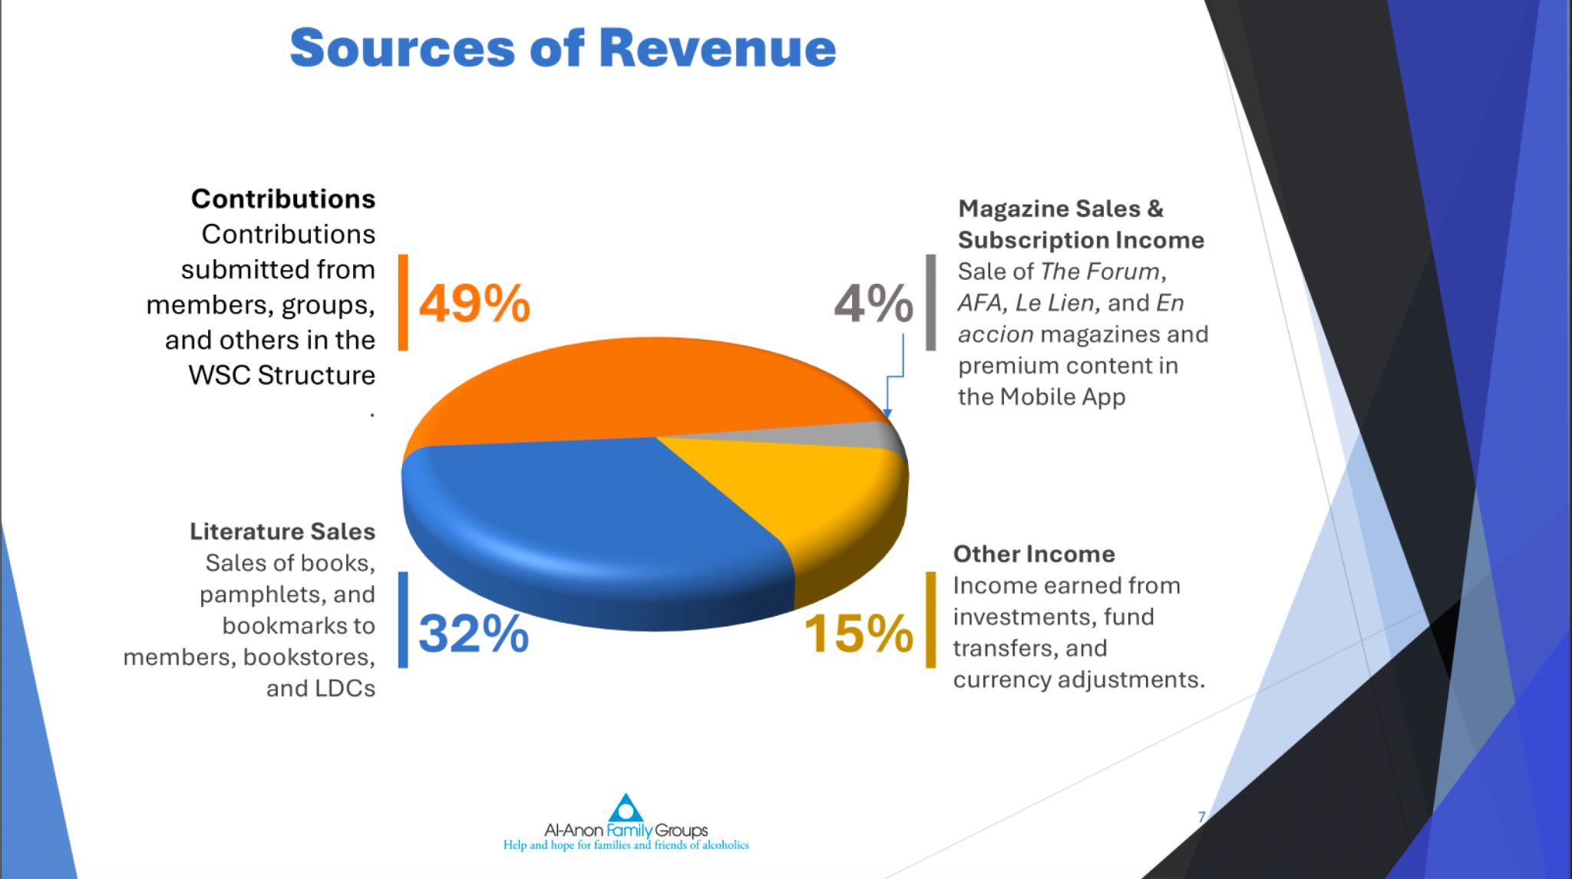

Slide 12
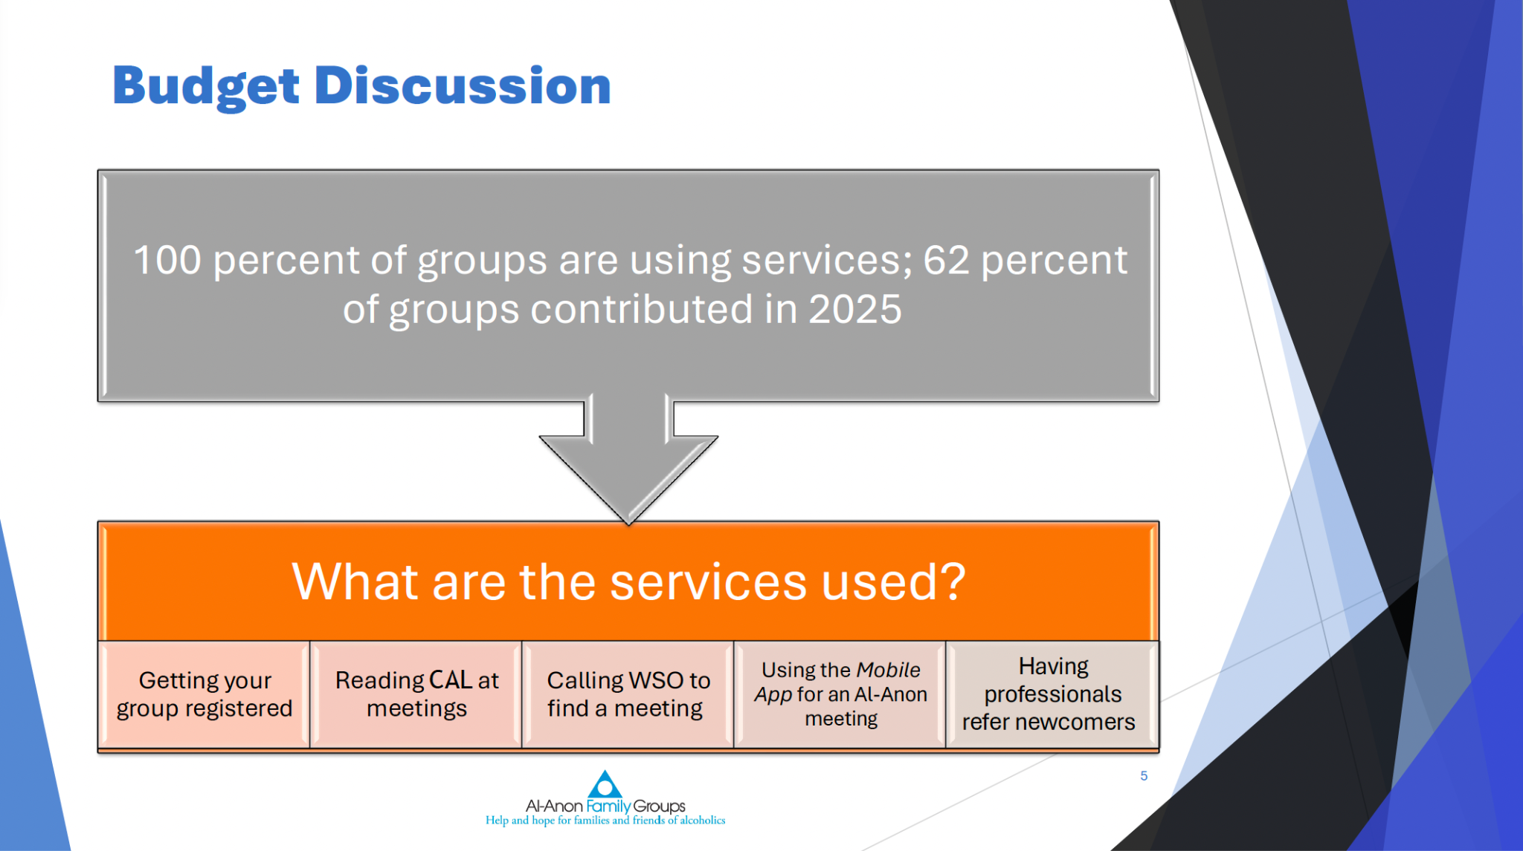

Slide 13
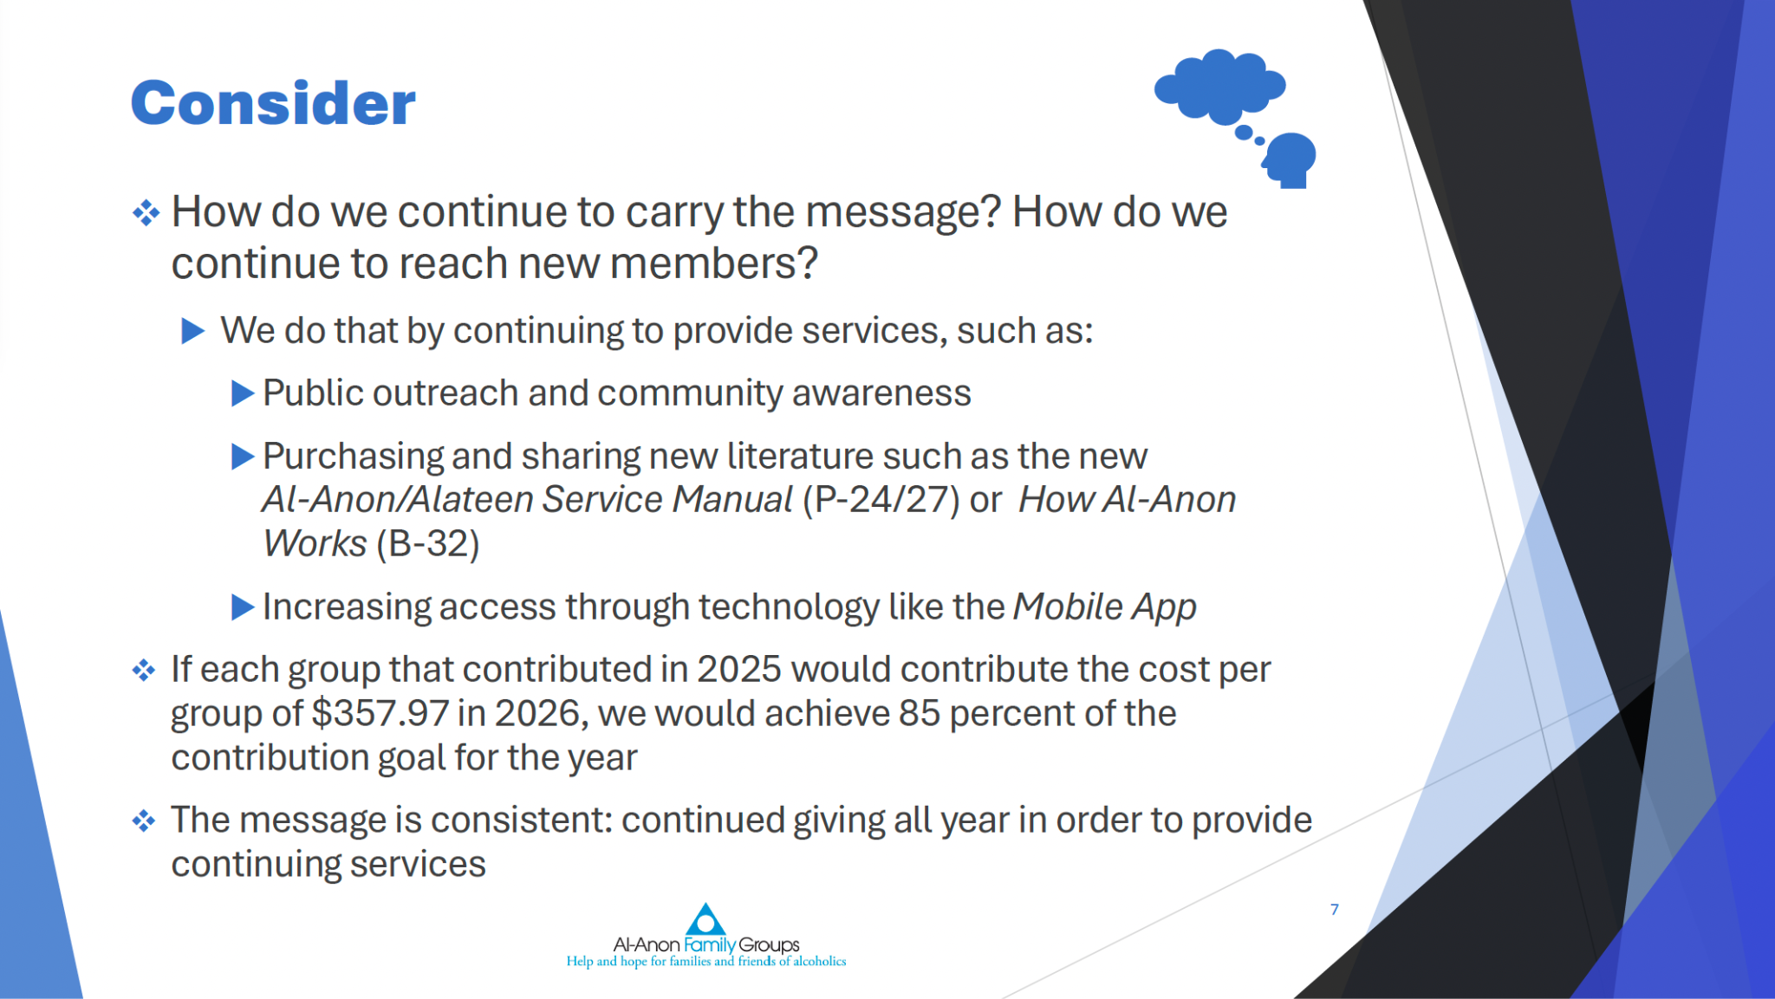

Slide 14
WSC: Area Inventories
A World Service Conference Delegate Work Group prepared and delivered a presentation on “Applying Step Four to Encourage Area Inventories”.
Several Areas routinely conduct inventories; 2nd or 3rd year of each panel.
Some Areas have created a guideline for the task.
Some Areas delegate the task to the Alternate Delegate.
Some Areas delegate the task to the Chair.
Some Areas use outside resources.
Should we regularly conduct an Area Inventory?

Slide 15
Last thoughts before lunch :
WSO is Hiring – Member Services Specialist with Remote Work possibilities
Member Services Specialist – International position is open! Application deadline: May 25, 2026. See the listing at employment.al-anon.org. For the right person, they will consider hybrid or remote work!
Associate Director, Programs will be opening in the future! They are exploring the exact needs at this time. For the right person, they will consider hybrid or remote work also.
Road Trip 2027 – Where will it be? Bids are due September 11, 2026. Do we want to apply?

Slide 16
More last thoughts before lunch:
2028 Al-Anon International Convention in Minneapolis, MN
July 20–22,2028; Registration opens September 2027
If you plan to fly and stay in the adjoining hotel…
$69/mo. for solo travelers
$49/mo. for sharing a room
Member written sharing's are needed for new CAL
Sponsorship/Service Sponsorship: Last call for member submissions! Deadline: June 30, 2026
Will be released at the 2028 International Convention
Finances in Recovery: Open call for member submissions
The FORUM: On-going

Slide 17
And more:
75th Anniversary Gala: 75 Years, One Purpose
Today, more than 22,000 Al-Anon groups meet in over 140 countries, along with 1100 Alateen groups. Al-Anon literature is available in over 40 languages.
While celebrations are encouraged locally, the WSO held a special 75th Anniversary event, including:
  An open house at the WSO offices
  A banquet dinner with historical videos and spiritual speakers

Slide 18
And lastly:
Growing Future Leaders – Passing it On (PIO)
A new program under development to facilitate knowledge sharing in service from one generation to the next!
Envisions WSO Staff collaborating with past Delegates and Trustees to identify educational gaps and missing institutional service knowledge.
The PIO Task Force is charged with overseeing the creation of study guides and toolkits designed to help members receive the service baton with confidence and pass it on with clarity. These tools will be available to the whole fellowship.
WSO will be seeking members to act as Content Developers, who bring not only service experience but also the ability to present and prepare materials, collaborate, receive feedback, and who carry the Legacies as a lived practice.
Are you such a person? Stay tuned for information to apply!

Slide 19
Pause for Lunch

Slide 20
Electronic Alateen Background
2020 - Strategy Approved.
2021 - International Legal Review.
2022 - Concept Presented at WSC.
2023 - New EAVIP Strategy.
2024 - Electronic Alateen Safety & Behavioral Requirements (EASBR) Introduced.
2025 - Implementation planning.
2026 - Time to vote!

Slide 21
About Electronic Alateen Meetings
Meeting Requirements
  Only teens in the WSC Structure (US, Canada, Bermuda, Puerto Rico) can attend.
  EVENTS (like workshops, conferences) are not MEETINGS. Electronic Alateen Validation and Implementation Planning (EAVIP) applies only to MEETINGS.
Teen Requirements
  Must be age 13-18
  Must complete a short pre-meeting interview with AMIAS-E to verify name and age.
  Must provide emergency contact information for custodial parent or legal guardian.
AMIAS-E Requirements
  Becomes a mandatory reporter; reports in their Area of residence.
  In addition to certification, must pass a background check that verifies they have not been convicted of a felony or charged with child abuse or any other inappropriate sexual behavior.

Slide 22
AMIAS + AMIAS-E
Sponsors for Electronic Alateen Meetings complete:
AMIAS Certification
AMIAS-E Certification
Background check every 2 years
Additional Duties
Conducting pre-meeting interviews with teens to verify name and age.
Maintaining list of teens interviewed and approved for admittance.

Slide 23
Mandatory Reporting and Hybrid Meetings
All AMIAS-Es are mandatory reporters regardless of state requirements. They report to their own state.
The electronic portion must have an AMIAS-E.
All EASBR and safety minimums must be met for electronic portion.
AMIAS-E Serves their Area
The Area needs to opt in.
AMIAS-E is certified in their Area.
The Area maintains their records.
AMIAS-E Serves another Area
Both Areas need to opt in.
AMIAS-E is certified by the Area in which they reside.
The receiving Area verifies the AMIAS-E status in the area of residence.
AMIAS-E Serves the GEA
AMIAS-E is certified by the Area in which they reside.
The GEA verifies the AMIAS-E status in the area of residence.

Slide 24
What’s Next?
August 2026 Training: Area Alateen Coordinators, AAPPs, and Delegates receive training on the process.
2026: We discuss whether our Area wants to opt in to hosting Electronic Alateen Meetings.
When discussion concludes, we’ll vote on a motion to opt in or not.
Next steps depend on what we decide…

Slide 25
Pause for Workshop

Slide 26
Delegate take-aways at WSC
Let’s talk about what we get to do, not what we can’t do.
Think about what unites us and think abundantly.
We will be guided by the principles found in our Legacies and all participate equally in WSC as members.
Am I going to go where I am accepted or go where everyone is accepted?
Al-Anon is for the friends and families of alcoholics who also practice the Twelve Steps. We are not just observers; we are in recovery.
We are all spiritual clearinghouses.
It is important for members to know that only three people handle customer service for the entire world. Be patient with them.
Leadership isn’t about having the loudest voice. It’s about listening with humility.
The undying efforts and hard work that everyone has put it, especially the Staff and Board…the ability to bring to us the true spirit of the Legacies.

Slide 27
What are your take-aways from today?

Slide 28
Before you go…
FORUM Subscription winner.
Silent Auction – pay Jane or Venmo @Crystal-Hegemann.
Love Gifts – share with your groups; talk about what your group may send to WSC next year.
Light weight items that compress (think bookmarks and stickers).
Images and artwork that reflects beautiful Utah.
Feedback Evaluation Form – give to Beth.
7th Tradition Box – All donations go to the Area.

